Slide 1
Introduction to Data Communication and Computer Networks
CS 2103
Data Communication and Computer Networks

Slide 2
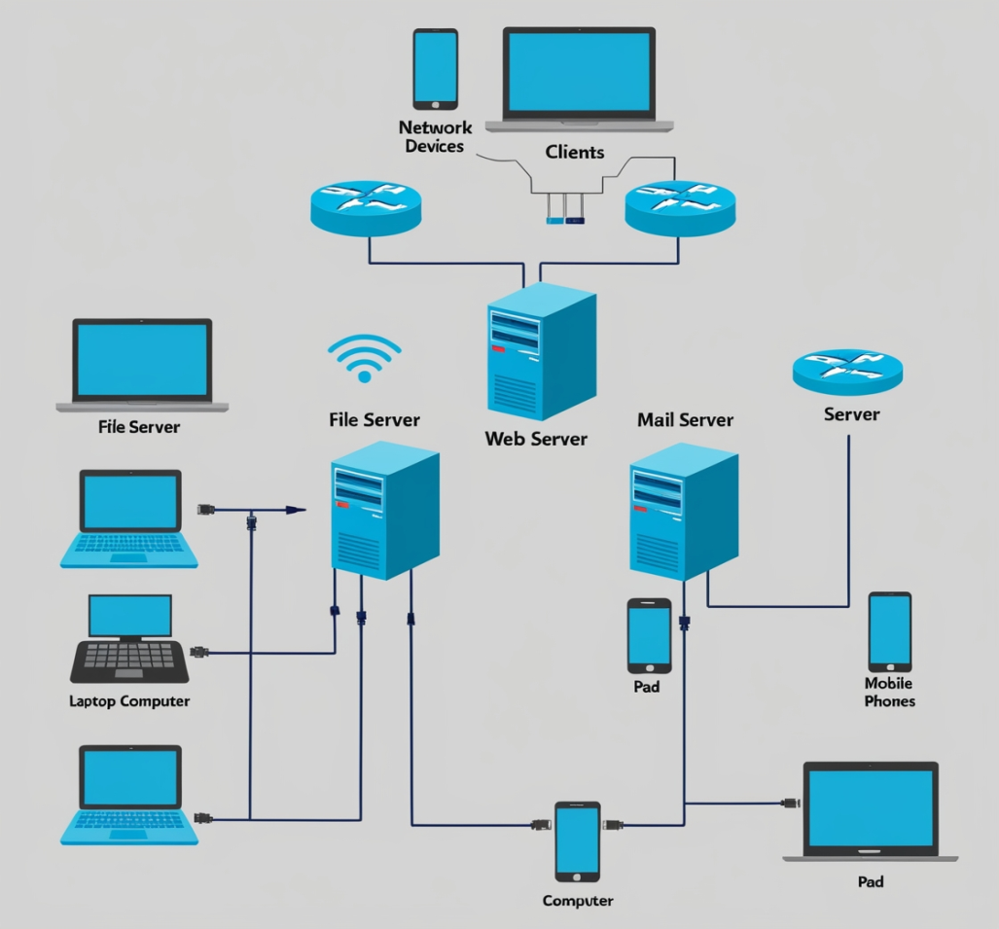
Introduction
A computer network is a collection of interconnected devices (computers, servers, routers, switches, etc.) that communicate with each other to share resources, such as files, applications, and internet access.

Slide 3
Types of Computer Networks
Local Area Network (LAN): Covers a small geographic area, such as a single building or campus. Used for connecting personal computers and devices.
Wide Area Network (WAN): Spans a large geographic area, often connecting multiple LANs. The internet is the largest WAN.
Metropolitan Area Network (MAN): Covers a city or a large campus, connecting multiple LANs within that area.
Personal Area Network (PAN): A small network for personal devices, typically within a range of a few meters (e.g., Bluetooth connections).
Body Area Network (BAN): is a network of wearable or implantable devices (small, low-power devices that collect and transmit data about the body.

Slide 4
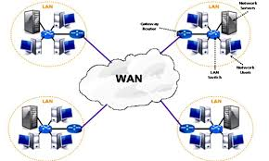
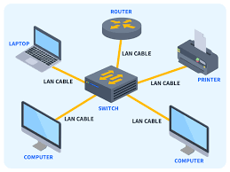
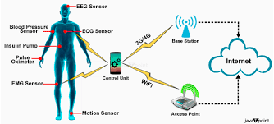
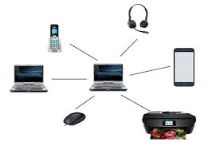
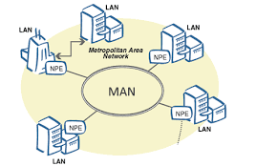
Types of Networks
WAN
LAN
BAN
MAN
PAN

Slide 5
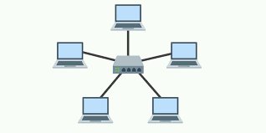
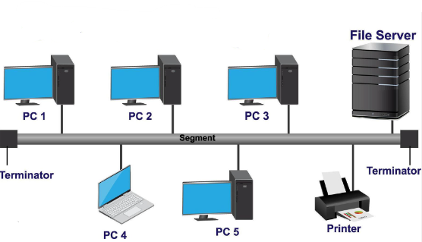
Network Topologies
Star Topology: All devices are connected to a central hub or switch. Easy to manage but can be affected if the hub fails.
Bus Topology: All devices share a single communication line. Simple but can lead to data collisions and is less reliable.

Slide 6
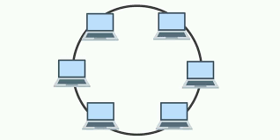
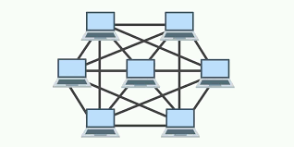
Network Topologies-Cont.
Ring Topology: Each device is connected to two other devices, forming a closed loop. Data travels in one direction; a failure in one device can disrupt the entire network.
Mesh Topology: Each device is connected to multiple other devices. Provides high reliability and redundancy but can be complex and costly to set up.

Slide 7
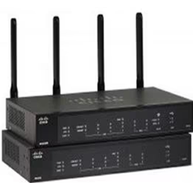
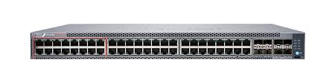
Networking Devices
Router: Connects different networks and directs data packets between them. Operates at the network layer (Layer 3) of the OSI model.
Switch: Connects devices within a LAN and uses MAC addresses to forward data to the correct device. Operates at the data link layer (Layer 2).

Slide 8
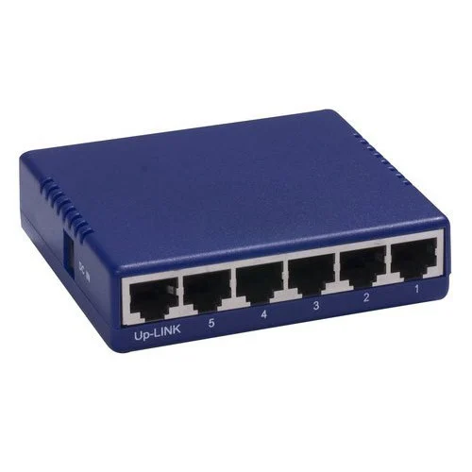

Networking Devices-Cont.
Hub: A basic device that connects multiple Ethernet devices, making them act as a single network segment. Operates at the physical layer (Layer 1).
Access Point: Allows wireless devices to connect to a wired network using Wi-Fi.

Slide 9
Protocols
Protocols are standardized rules for data communication. Some common network protocols include:
Transmission Control Protocol (TCP): Ensures reliable, ordered delivery of data packets between devices.
Internet Protocol (IP): Responsible for addressing and routing packets of data so they can travel across networks.
Hypertext Transfer Protocol (HTTP): Used for transferring web pages on the internet.
File Transfer Protocol (FTP): Used for transferring files between computers.

Slide 10
IP Addressing
An IP address is a unique identifier assigned to each device on a network. It can be:
IPv4: A 32-bit address written in decimal format (e.g., 192.168.1.1). It supports approximately 4.3 billion unique addresses.
IPv6: A 128-bit address written in hexadecimal format, designed to accommodate the growing number of devices on the internet (e.g., 2001:0db8:85a3:0000:0000:8a2e:0370:7334).

Slide 11
Network Layers (OSI Model)
The Open Systems Interconnection (OSI) model divides network communication into seven layers:
Physical Layer: Deals with the physical connection and transmission of raw data (cables, switches).
Data Link Layer: Provides node-to-node data transfer and handles error correction (switches, MAC addressing).
Network Layer: Manages data routing and addressing (routers, IP addresses).
Transport Layer: Ensures reliable data transfer and error recovery (TCP, UDP).
Session Layer: Manages sessions between applications (establishing, maintaining, and terminating connections).
Presentation Layer: Translates data formats, encrypts, and compresses data (data formatting).
Application Layer: Interfaces with the user and application software (HTTP, FTP).

Slide 12
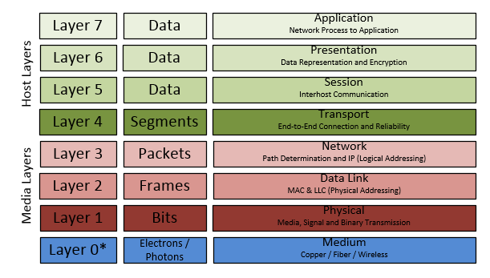
OSI Model

Slide 13
Data Transmission/ Communication
Analog vs. Digital Signals: Data can be transmitted as analog (continuous signals) or digital (discrete signals).
Bandwidth: The maximum rate of data transfer across a network path, usually measured in bits per second (bps).
Latency: The time it takes for data to travel from the source to the destination, often measured in milliseconds (ms).

Slide 14
Network Security
Network security involves protecting data during transmission and preventing unauthorized access. Key concepts include:
Firewalls: Control incoming and outgoing network traffic based on predetermined security rules.
Encryption: Scrambles data to prevent unauthorized access during transmission.
Virtual Private Network (VPN): Creates a secure connection over a less secure network, like the internet.

Slide 15
Cloud Computing and Networking
Cloud computing relies on networks to provide services and resources over the internet. Concepts include:
Public Cloud: Services offered over the public internet, accessible to anyone.
Private Cloud: Dedicated infrastructure for a single organization, providing more control and security.
Hybrid Cloud: Combines public and private clouds, allowing data and applications to be shared between them.

Slide 16
Basics of Computer Network
Network services provide functionality to devices connected to a network. Applications interact with these services to communicate or transfer data.
Key Services:
File sharing
Email
Web Browsing
Remote Access
Applications: Services used by end-users (e.g., browsers, email clients).

Slide 17
Network Services
Network services are the fundamental applications and functionalities that enable communication, resource sharing, and data management within a network.
These services include:
Domain Name System (DNS)
Dynamic Host Configuration Protocol (DHCP)
File Transfer Protocol (FTP)
Email Services including the Simple Mail Transfer Protocol(SMTP), Internet Message Access Protocol(IMAP), and Post Office Protocol (POP3).
Web Services (HTTP/HTTPS
Directory Services
Remote Access Services (VPN)

Slide 18
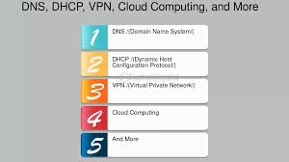
Importance of Network Services
Network services are essential to the functionality, security, and reliability of both private and public networks, enabling communication, enhancing productivity, and supporting business growth and continuity.

Slide 19
Domain Name System (DNS)
Purpose: Translates domain names (e.g., www.suza.ac.tz) into IP addresses.
Key Functions:
Name Resolution: Maps domain names to IPs.
Hierarchical Structure: Root servers, TLDs, authoritative DNS servers.
Process: Recursive and iterative queries.

Slide 20
How DNS Works
Steps:
User enters a URL (www.https://suza.ac.tz).
Browser sends a DNS query to a DNS server.
DNS server responds with the IP address.
Browser connects to the server via the IP address.
Diagram: Step-by-step DNS request with flow from client to server and response.

Slide 21
Hypertext Transfer Protocol (HTTP)
Purpose: The protocol used for transmitting web pages.
Key Features:
Stateless: Each request/response pair is independent.
Methods: GET, POST, PUT, DELETE, etc.
HTTPS: Secure version of HTTP using TLS.
Diagram: Client-server HTTP request/response interaction (with packets and their contents).

Slide 22
Simple Mail Transfer Protocol (SMTP)
Purpose: Protocol used to send and receive emails.
Key Features:
Communication: Between email servers to route mail.
Ports: Typically uses port 25 (SMTP), 587 (SMTP secure).
Workflow: Email travels from the sender's mail client to the recipient's mail server.
Diagram: SMTP email flow from sender to recipient, showing interaction between mail servers.

Slide 23
Peer-to-Peer Systems (P2P)
Definition: Decentralized communication model where each node (peer) acts as both a client and a server.
Characteristics:
No central server.
Files and services distributed across peers.
Examples: File sharing (BitTorrent), blockchain systems.
Diagram: A P2P network where all nodes communicate with each other directly.

Slide 24
Comparison of Client-Server vs Peer-to-Peer
Models
Client-Server:
Centralized control.
Easier management but can be a single point of failure.
Peer-to-Peer:
Decentralized, scalable.
Higher fault tolerance, harder to manage.
Diagram: Side-by-side comparison of a client-server network vs a peer-to-peer network.

Slide 25
Real-World Applications of Network Services
DNS: Used for translating URLs to IPs.
HTTP/HTTPS: Accessing web pages.
SMTP: Sending and receiving emails.
P2P: File-sharing services like BitTorrent, decentralized applications.
Infographic: Icons and examples of each service's real-world application.

Slide 26
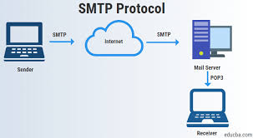
SMTP
The Simple Mail Transfer Protocol (SMTP) is a technological standard for sending email over a network. SMTP, like other networking protocols, enables computers and servers to communicate data regardless of the underlying technology or software. Just as using a defined form of addressing an envelope allows the postal service to function, SMTP standardizes how email goes from sender to recipient, allowing for widespread email delivery.

Slide 27
P2P
A peer-to-peer network is a simple collection of computers. It originated in the late 1970s. Each computer serves as a node for file sharing within the established network. In this case, each node serves as a server, hence the network has no one central server.
This enables the sharing of massive amounts of data. The duties are equally distributed across the nodes.
Each node in the network has an equal workload. To stop the network from working, all of the nodes must stop working independently. This is because each node operates separately.

Slide 28

Case Study

Slide 29
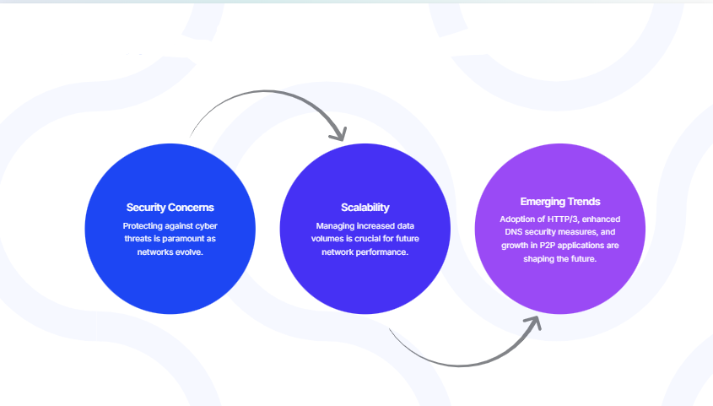
Challenges and Future Trends

Slide 30
Thank you

